Slide 1


DAB401
FINANCIAL ANALYTICS
St. Clair College
Walmart Stock Analysis
Group Members
Apurv Sathwara
Bhakti Bhatt
Dhrumi Patel
Smit Arora
Vismay Lad

Slide 2
Agenda
Introduction
Company Valuation
Business Model
Competitors
Market Share
Balance Sheet
Ratio Analysis
Recommendation

Slide 3

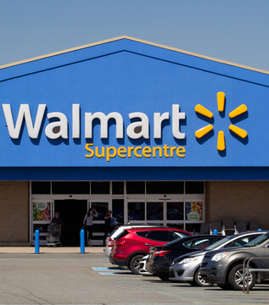
About Company
Walmart is an American multinational retail corporation that operates a chain of discount department stores, grocery stores, and hypermarkets.
Founded in 1962 by Sam Walton in Bentonville, Arkansas, Walmart has become one of the largest retailers in the world with over 11,000 stores in 27 countries.
The company is known for its low prices and wide range of products, including clothing, electronics, groceries, and household items.
Walmart has also been a pioneer in the use of technology, implementing advanced inventory management systems, automated warehouses, and digital innovations to enhance the customer experience. With a focus on innovation, sustainability, and community engagement, Walmart has become an iconic brand that has changed the face of retailing around the world.

Slide 4
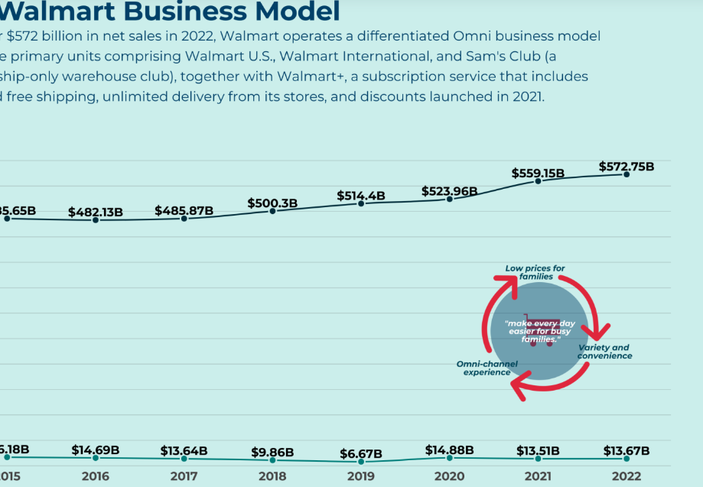
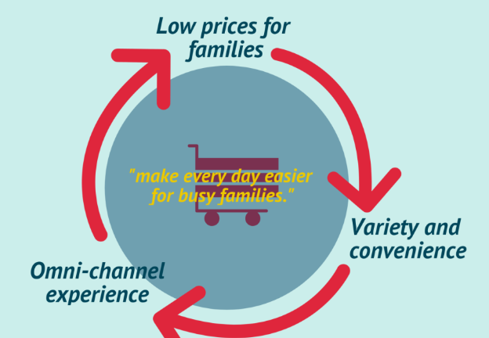
Business Model
With over $555 billion in net sales in 2021, the company operates a differentiated Omni business model with three primary units comprising Walmart U.S, Walmart International, and Sam’s Club (approximately 12% of its net sales) a membership-only warehouse club. Together with Walmart+, a subscription service including unlimited free shipping, unlimited delivery from its stores, and discounts launched in 2021.

Slide 5









Competitors

Slide 6

Top industrial competitors:
Costco- Approx market share around 9%.
Loblaws- Loblaws held the top spot with an estimated 28% share of the grocery retail industry in Canada.
Sobeys- Market share around 20%.
Metro- Has about 11% of MS among all.
Target- lowest among all which is 3.2%.

Slide 7
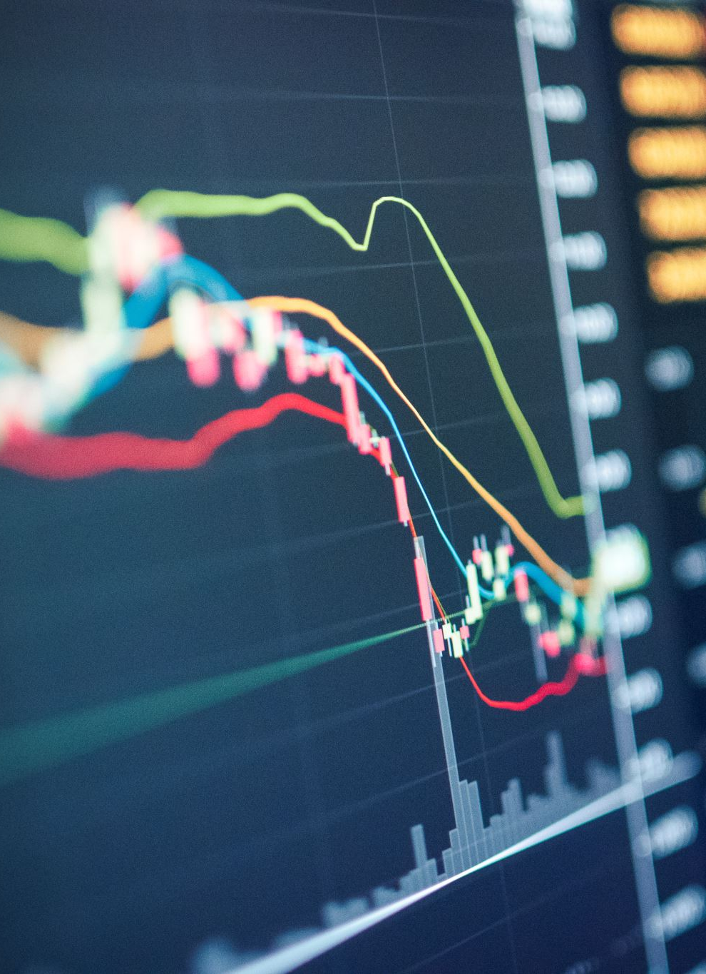
Market Share
48.00% of Shares Held by individual shareholders
16.62% of Shares Held by other Institution
16.17% of Shares Held by Mutual fund Holders

Slide 8
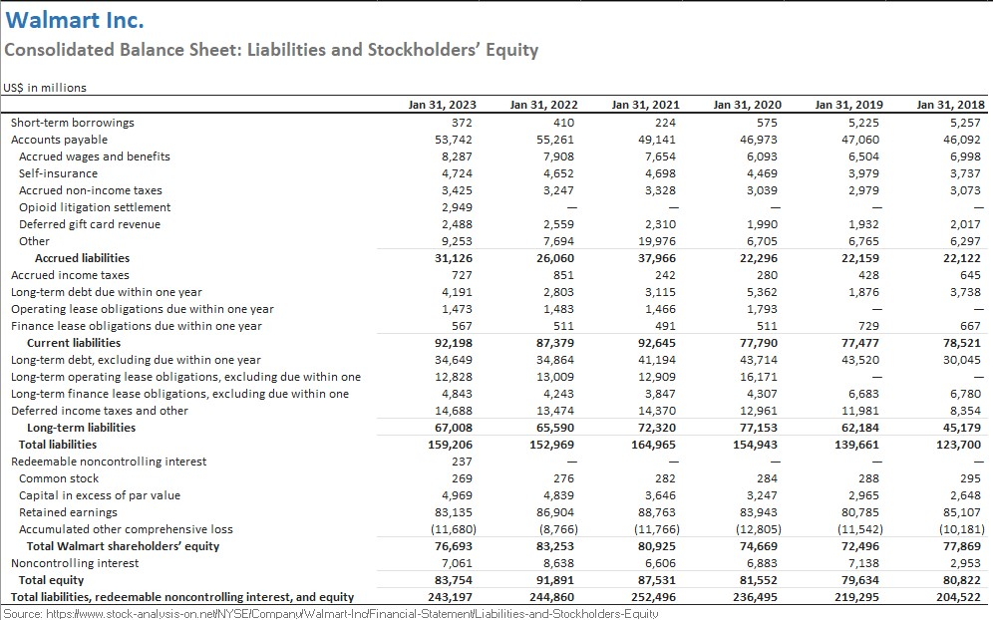
Balance Sheet

Slide 9
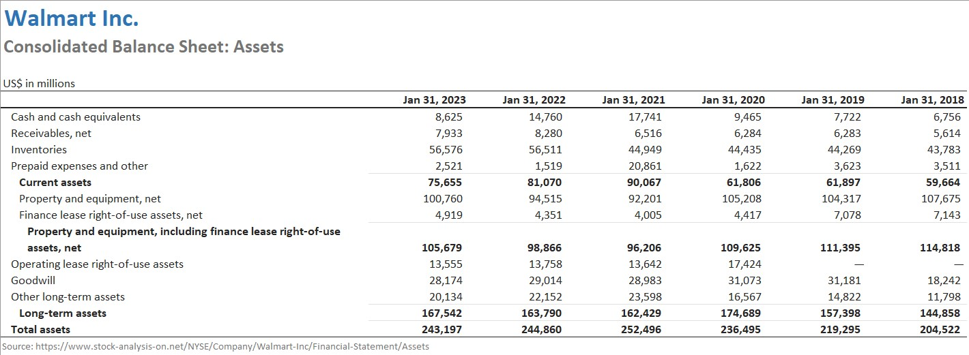
Ratio and valuation Analysis using Ratio Analysis

Slide 10
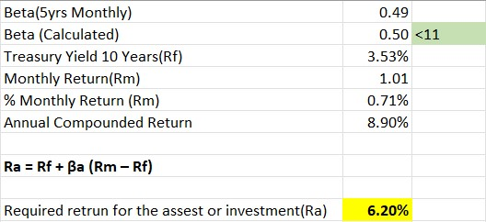
Ratio and valuation Analysis using CAPM

Slide 11
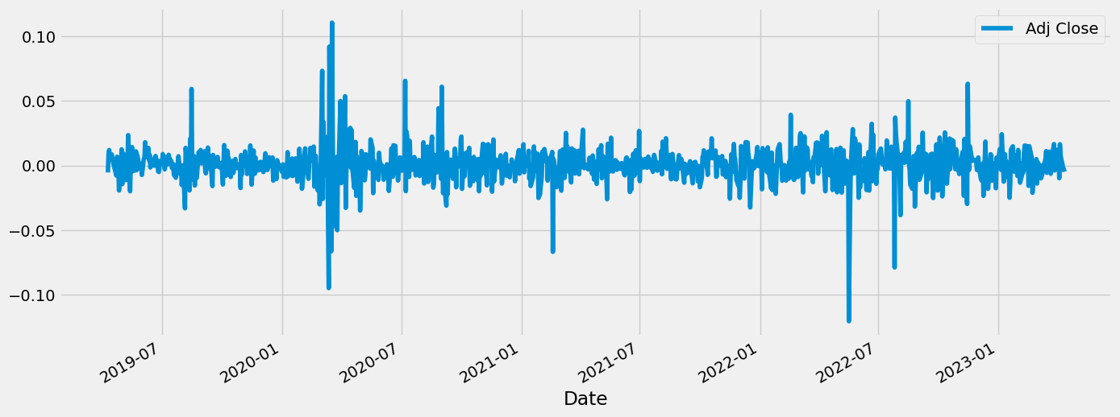
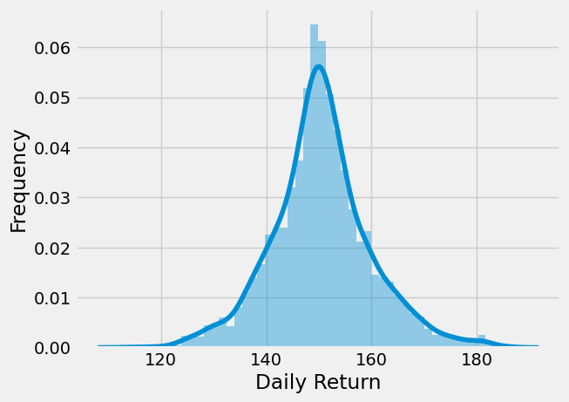
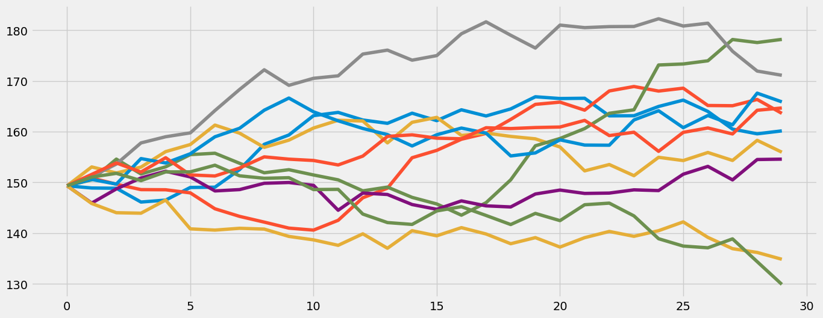
Monte Carlo Simulation

Slide 12
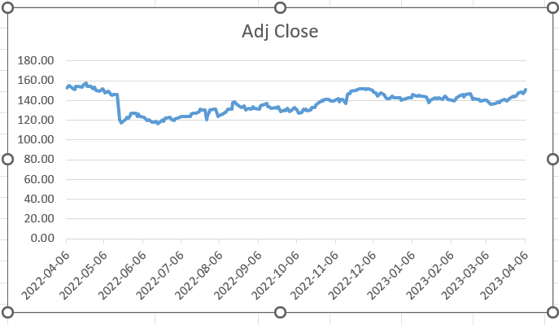
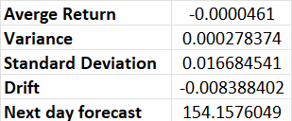
Monte Carlo Simulation
After running a Monte Carlo simulation of Walmart's adjusted closing price for the past two years, it was found that the expected average stock price for the next 30 days is higher than the current market price.
This implies that there is a possibility of a rise in the stock price in the short term.
Nevertheless, investors must note that this simulation does not ensure future stock price movements and further research and analysis should be conducted before making any investment decisions.
Furthermore, stock investment involves risks, and past performance may not predict future results.

Slide 13
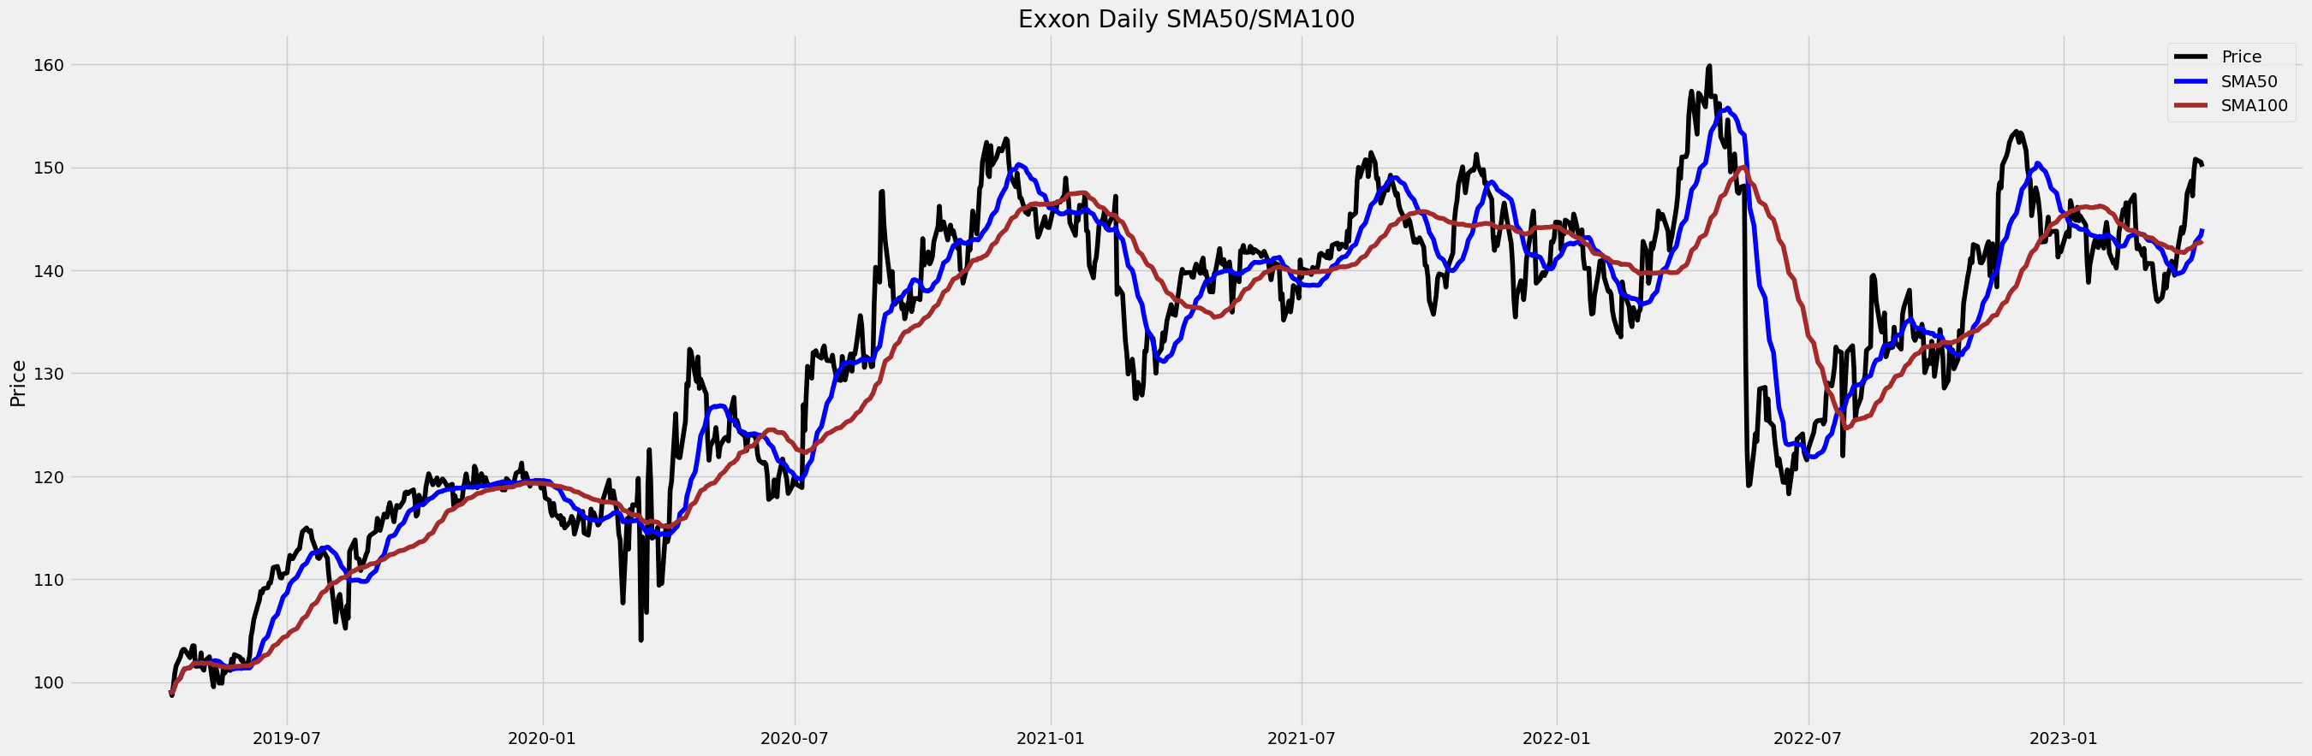
Simple Moving Average
As you can see in the plot, we have our stock's closing price as a 50-day and 100-day simple moving average.

Slide 14
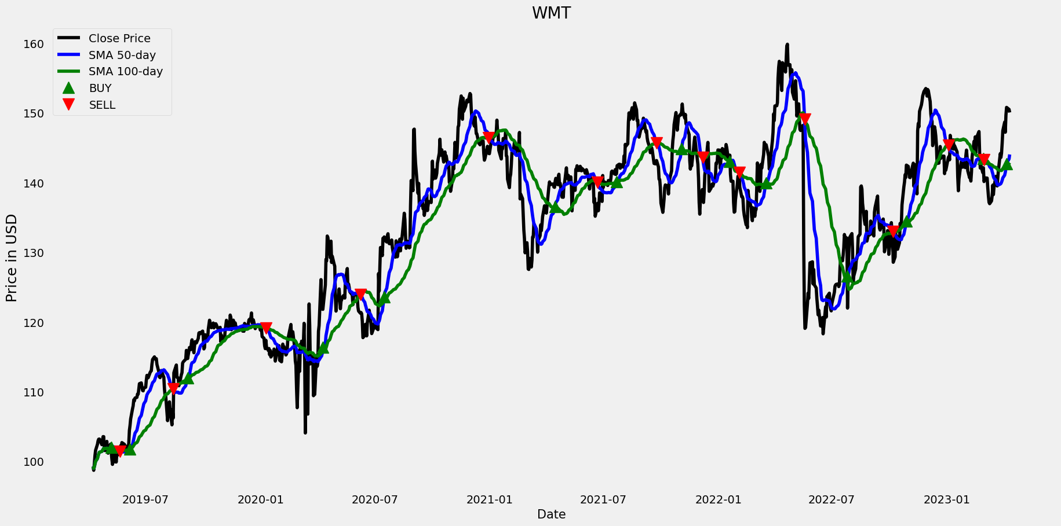
Exponential Moving Average
As you can see in the plot, our stock's closing price is 50 days old and 100 days old for the exponential moving average with a buy and sell indicator.

Slide 15
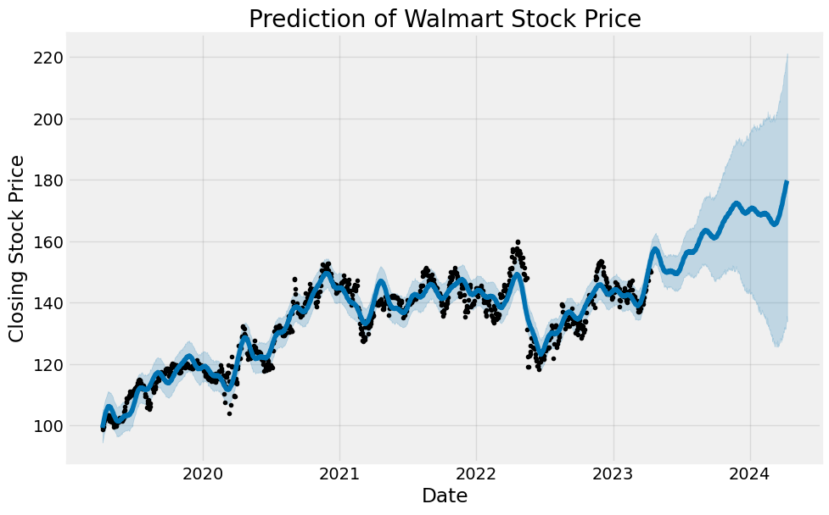
Facebook Prophet Analysis
This analysis shows a prediction of Walmart's stock price until 2024.

Slide 16
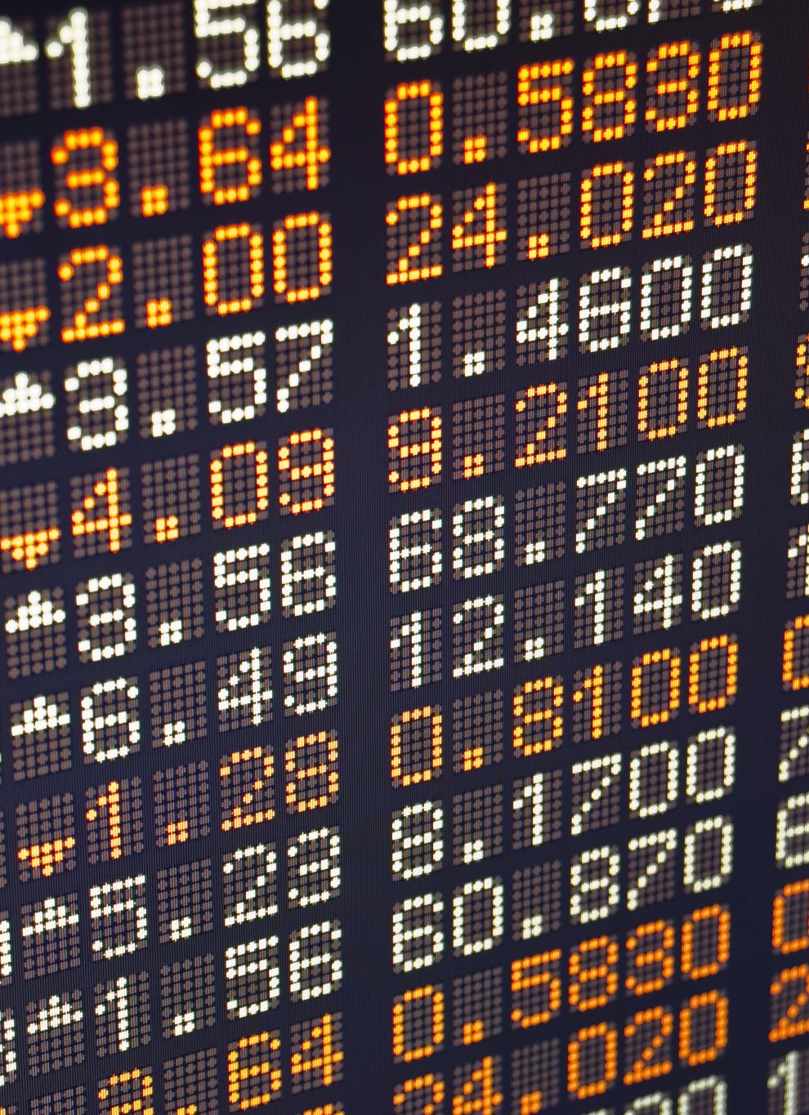
Recommendation
Walmart is a major global retailer whose stock is regarded as a blue chip. Walmart's fundamentals may be shifting from what was formerly thought of as a value investment.
Costco and Amazon can't match the company's impressive financial performance.
Walmart outperforms its two main competitors in terms of price-to-earnings and price-to-book ratios, but falls short in terms of return on equity, debt-to-equity ratio, and current ratio.

Slide 17

References
https://pestleanalysis.com/walmart-pestle-analysis/
https://fourweekmba.com/walmart-business-model/
https://businesschronicler.com/competitors/walmart-competitors-analysis/
https://csimarket.com/stocks/competitionSEG2.php?code=COST
https://csimarket.com/stocks/competitionSEG2.php?code=TGT
https://csimarket.com/stocks/competitionSEG2.php?code=HD
https://csimarket.com/stocks/competitionSEG2.php?code=BBY
https://www.feedough.com/the-history-of-walmart/

Slide 18

Thank you

